Slide 1
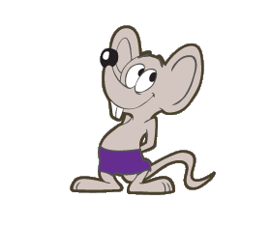


Review – Current Condition
Coastal Populations
Beach Bums
Message in a Bottle (MIB)
Cannibal Cove
Castaways
Paradise Palm Populations
Snowmelt Thicket
Dead Man Dunes
Treasure Grove
Realm of Spirits
Mountain Populations
Misty Mountain
Darlost’s Dome
Notes:
Briefly look at what we discussed yesterday and ask for lingering questions before moving forward.

Slide 2

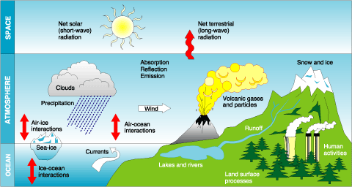
Review – Current Condition
Notes:
What were some of the stressors that you felt were MOST influencing the Island Mouse’s current condition?

Slide 3
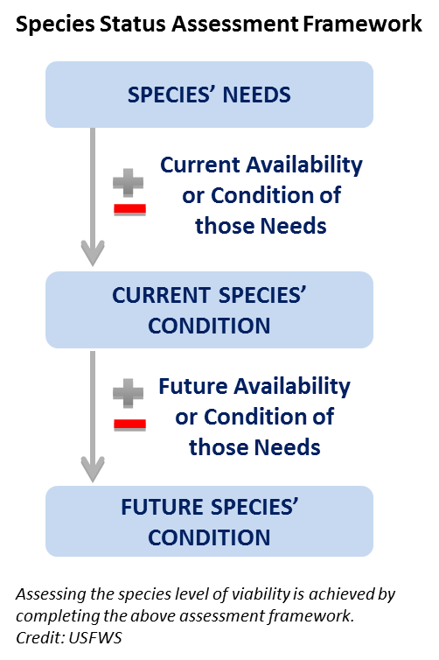
Future Condition
Notes:
Today we will focus our time on the third part of the SSA Analytical Process – the Future Condition. This part of the SSA forecasts the species’ response to probable future scenarios of environmental conditions and conservation efforts.

Slide 4
Future Condition
“It is very difficult to predict — especially the future.”
Danish physicist Neils Bohr

Slide 5
Future Condition
Then why make predictions?
Because risk assessments to inform ESA decisions require an understanding of the likely future condition of the species and its environment (Carroll et al. 1996, DeMaster 2004).
To answer:
“And then what?” or
“So, what does that mean to the species?”
Relies on species ecology, cause-effect relationships, and current condition

Slide 6
Future Condition
Future
Condition
Current Condition
GOAL
SPECIES METRIC
PRESENT
T I M E
Notes:
ANIMATED SLIDE
Should we remove the “goal” line after the pilot? This slide first appears in Current Condition, slide 5. If we make changes here, make them there, too.

Slide 7
Scenario Development
Future Condition
Possible futures: what may happen?
Probable futures: what is most likely to happen?
Preferable futures: what would we prefer to happen?
(Duinker & Greig 2007)
Notes:
Duinker, P. N., & Greig, L. A. (2007). Scenario analysis in environmental impact assessment: Improving explorations of the future. Environmental impact assessment review, 27(3), 206-219.

Slide 8
Future Condition
Components
Stressors, including climate change
Conservation efforts
Species’ response
Habitat condition
3Rs
Viability
Notes:
AFTER PILOT:
Erin is going to create a slide to insert after this one to address “What’s our short list on process for developing future scenarios?” How do we decide what goes into scenarios?
For now, add discussion in Tucson, whoever is instructing here.

Slide 9
Future Condition
Scenarios depend upon decision context
Listing
Stressors and conservation efforts
Consultation
Project vs no project
Project design options
Reasonable and prudent measures
Recovery
Alternative recovery strategies

Slide 10
Future Condition
Timeframes: biologically meaningful and consistent with the information available
Discuss how ES decision makers have determined appropriate timeframe
Discuss the appropriate spatial scale
Notes:
Might be best to rephrase the second and third bullets as questions.

Slide 11
Future Condition
Schwartz (1996) recommends 2 to 5 contrasting scenarios
Cornish (2004) recommends
Continuation scenario (baseline)
Pessimistic scenario
Disastrous scenario (worst case)
Optimistic scenario
Transformation scenario (best case)
Notes:
Cornish E. Futuring: the exploration of the future. Bethesda, MD: World Future Society; 2004. 313 pp.
Schwartz P. The art of the long view: planning for the future in an uncertain world. New York, NY: Currency Doubleday;
1996. 258 pp.

Slide 12
Future Condition
Some things to avoid
Developing too many scenarios
Inappropriate time frame and scope
Too limited a range of outcomes or possibilities
Too much focus on existing trends
Insufficient focus on drivers (e.g., stressors and conservation efforts)
Notes:
ANIMATED SLIDE. (Click for each bullet to appear)
We have a tendency of overestimating rare events and underestimating common events.
REMINDER: SSA is an updatable document!!! This should be adaptive.
Cornish E. Futuring: the exploration of the future. Bethesda, MD: World Future Society; 2004. 313 pp.
Schwartz P. The art of the long view: planning for the future in an uncertain world. New York, NY: Currency Doubleday;
1996. 258 pp.
AFTER PILOT: Animate slide

Slide 13

Scenarios for Page Springsnail SSA
Future Condition
How will groundwater pumping and drought affect spring flow in the future?
Climate Change – possible reduced precipitation and reduced groundwater recharge
Human Population Growth – possible increase in groundwater pumping
Both factors could reduce groundwater levels, but the relationship to spring flow rates are highly uncertain.

Slide 14
Scenarios for Page Springsnail SSA
Future Condition
Considered 50 years in the future.
Developed 3 spring flow scenarios for potential effects to spring flow.
Scenario 1: No change to spring flow occurs
Scenario 2: Some change to spring flow occurs (not drastic)
Scenario 3: Major reduction or elimination of spring flow
Notes:
Susan – why the 50 years?
Why did they focus on Scenario 2?

Slide 15
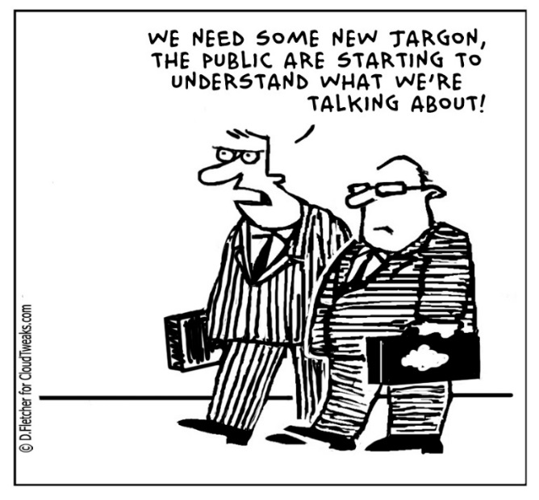
Future Condition
Scenarios capture uncertainty
Scenarios can represent hypotheses
Specify how likely are the scenarios
But avoid terminology being a source of uncertainty
Use calibrated terms

Slide 16
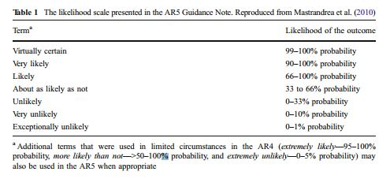
…recall IPCC Probability Table
Future Condition

Slide 17
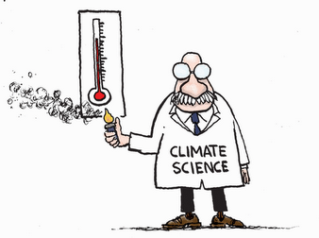
Future Condition
EXERCISE 9.
Scenario Development
9A – Evaluating Future Stressors
9B – Ecological Settings Scale
9C – Species Scale
Notes:
Scenario Development by Population and then by Ecological Setting.
Join with other populations in your Ecological Setting and do three scenarios for your Ecological Setting.
Reconvene class and discuss scenarios – come to agreement on three scenarios for the entire island (species). Fill out last Table, for the species, together.

Slide 18

Future Condition
Please be back at 1:00!

